Slide 1
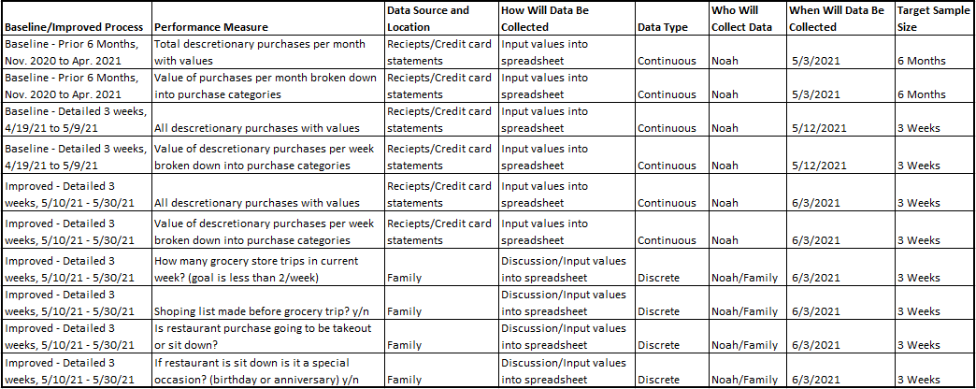
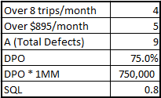
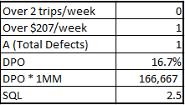
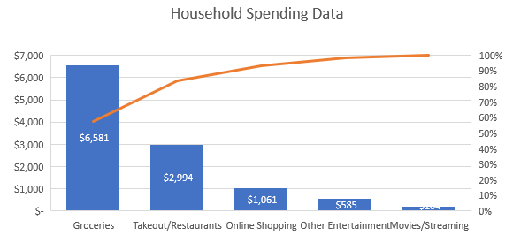
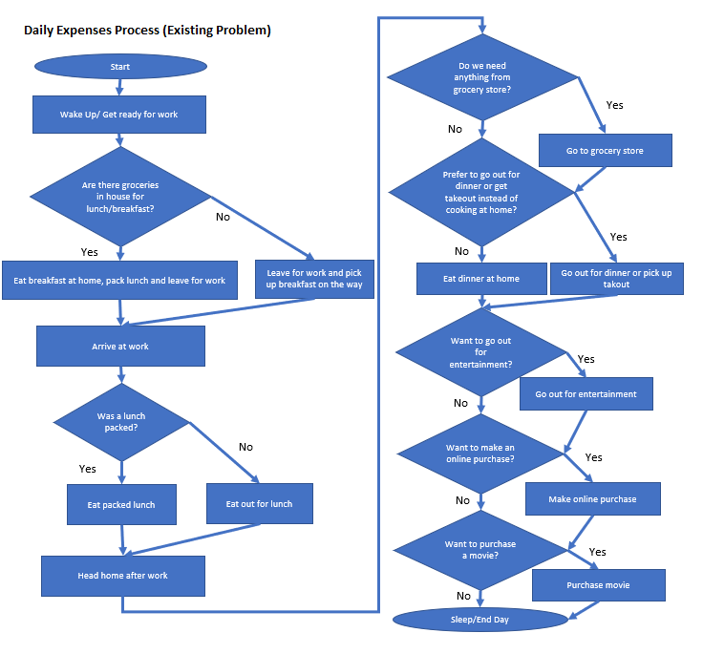
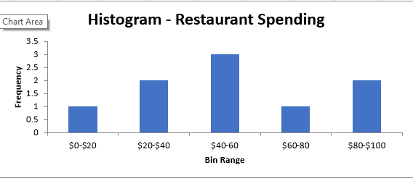
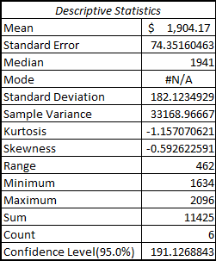
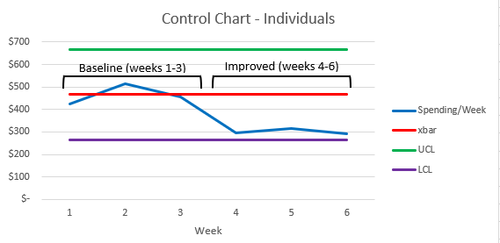


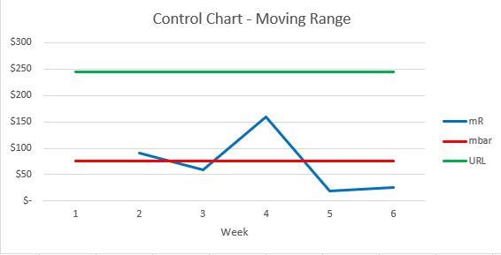
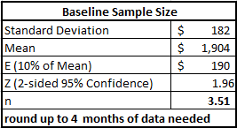

Reducing Household Expenses
Process owner: Noah Laraway
Key Dates --->
Team Launch
4/12/2021
Define
4/12/2021
Measure
4/19/2021
Analyze
5/3/2021
Improve
5/10/2021
Control
On-Going
DEFINE
MEASURE
ANALYZE
IMPROVE
Problem Statement
Household discretionary spending is too high and estimated to be over $200/month in unnecessary expenses due to minimal processes in place.
Identified what/how to measure
Pareto showed 83% of spending on groceries & restaurants!
Before
After
Current
Process
Is
Broken!
Sigma Quality Level shows too many grocery store trips and too much spent on groceries! SQL for groceries increased from 0.8 to 2.5 after improved process!
$1,900 per month on discretionary spending!
**Improved process reduced spending by $101/week! Exceeded goal of $50/week!**
Business Impact
Lowering expenses by $200/month would lead to annual savings of $2,400/year. If this money was invested it could lead to $157k over 25 years!
CONTROL
55% of restaurant spending coming from only one third of restaurant trips! Sit down restaurants are more expensive!
Baseline sample size of 6 months is sufficient for analysis.
Process in control & shows reduction in spending
Money
Being
Wasted!
Main Focus for Improvement:
Limit sit down restaurant trips
Limit grocery store trips
Put a cap on grocery store spending
Expected results: $50+ reduction in spending/week
Next Steps:
Continue to gather data for control charts
Address any outliers
Look at improving processes for other spending categories (Online shopping/etc.)
Team Members: Noah & Katie

Slide 2
What’s the goal and what do we need to achieve it?
Goal
Reduce household expenses by $200/month. $50/week with improvement plan due to time constraint for project.
Inputs
Discretionary expenses including previous 6 months (April 2020-present)
Includes: restaurant expenses, online purchases, movies/streaming, other entertainment & groceries
Outputs
Comparison of weekly expenses before/after improvement plan.
Business impact
$200/month, $2,400/year
Used financial calculator to estimate $157k in savings over 25 years
Data
Continuous: expenses in dollars, time
Discrete: trips to grocery store and restaurants, answers to questions about spending habits and following processes (y/n)

Slide 3
Process Map - Baseline
Baseline Process
Conclusions
There’s not much of a process in place.
Purchases are being made without checking if they’re necessary.
No checks in place for spending habits.
No budget or tracking of data is leading to not understanding what the money is being spent on.
**Need to add checks before making key purchases.**

Slide 4
Data Measurement Plan
Root causes of overspending
Not one shopping list made in baseline data.
Not reviewing recent grocery store purchases in baseline data.
Many restaurant sit down expenses were random and not a special occasion in baseline data.
Possible Measurement Error
Only credit card expense data was available. Although cash purchases are very rare for our family they could have had a minor impact that isn’t accounted for.

Slide 5
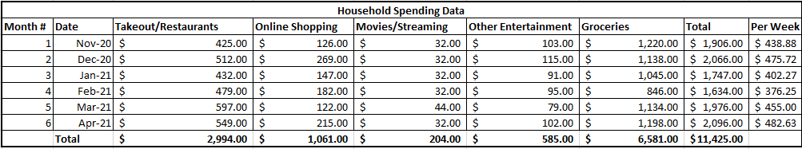
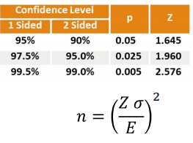

Sample Size – Baseline Process
Baseline Data (Prior 6 Months Discretionary Spending)
Calculation Data
Mean total spending = $1,904/month
Standard deviation = $182
Error = $190 (10% of mean)
Z (2-sided 95% confidence) = 1.96
n = 3.51
Round up to 4 months of data needed
Conclusion: 6 months is sufficient data at 95% confidence level
Convert mean from monthly to weekly for future analysis

Slide 6
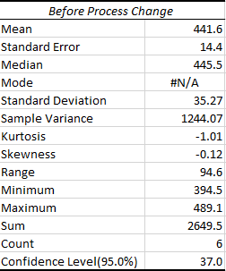
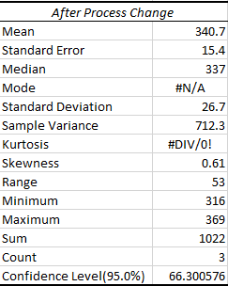
Descriptive Statistics
Comparison for weekly discretionary spending before and after process change.
Key takeaways
Mean spending was reduced from $441 to $340 ($101 reduction).
Variation, standard deviation and range also reduced.
**Although data looks to be improved it should be noted that only 3 weeks of improved data was available. Need to continue to add data points as they come in**.

Slide 7
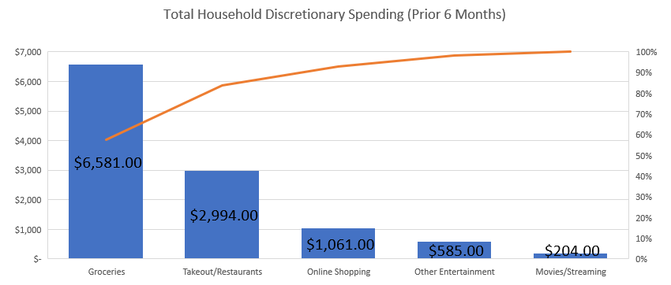
Pareto Chart – What are the main drivers for expenses?
83.8%
Key takeaways
Groceries and restaurants are the bulk of the discretionary expenses at 83.8%
I decided to put the main focus of this project on improving the process for groceries and restaurant spending since reducing them could have a larger impact on total expenses.

Slide 8
Restaurant Spending Histogram
Overview: An in depth analysis of every purchase was performed for the 3 weeks prior to implementing the improvement plan (4/19/21 to 5/9/21). This data was compared to the 3 weeks with the improvement plan (5/10/21 to 5/30/21). The below data compares restaurant spending from those time frames.
Before Improvement
After Improvement
Takeout (avg = $26)
Sit down (avg = $71)
Takeout
Sit down
55% of total
Wife’s Birthday
Conclusions from Baseline
Out of the 9 purchases, sit down restaurants were the top 5 most expensive while takeout purchases were the lowest.
Out of the 9 restaurant purchases, 3 of them accounted for 55% of the total spending. ($251 out of $456).
Process improvement plan will include checks to limit sit down restaurant purchases unless it’s a special occasion.
Conclusions from Improvement
Out of the 6 purchases only one was sit down.
Restaurant spending was reduced from $152/week to $80/week.

Slide 9
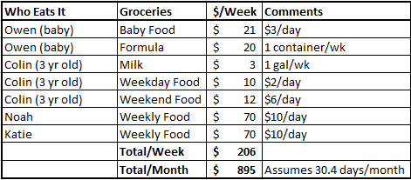


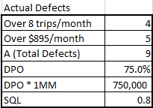
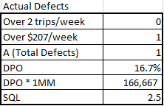
SQL for Grocery Trips and Spending
Defining the defects for grocery store spending and number of required trips per month
How much food do we need in $?
How many grocery store trips do we need?
Grocery Store | Monthly Trips
Costco | 2
Other Grocery Store | 6
Total/Month | 8
Total/Week | 2
Defect Definitions
More than 8 grocery store trips/month for baseline or 2 trips/week for improved process.
More than $895/month for baseline or $206/week for improved process.
Before Improvement - per month (6 months of data prior to improvement process)
After Improvement – per week (3 weeks of data)
Conclusions: Improved process had less grocery store trips and less overall spending on groceries. SQL improved from 0.8 to 2.5!

Slide 10
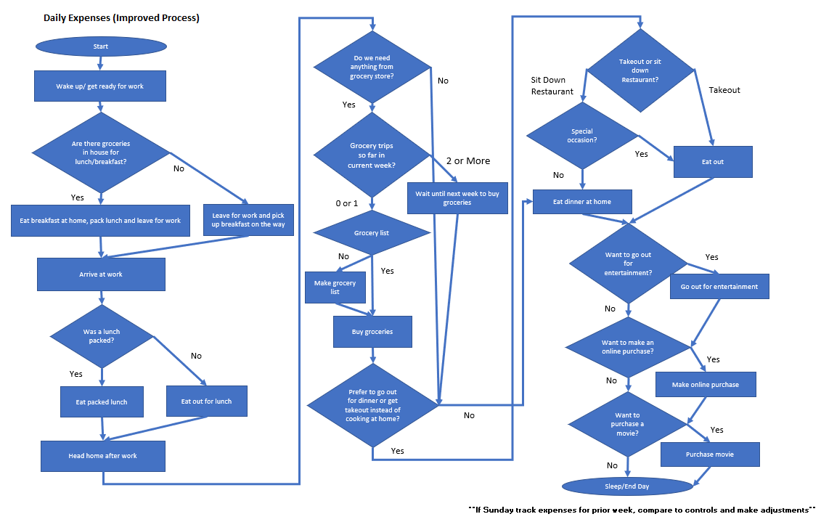
Process Map - Improved
Added checks for restaurant spending
Is it a take out or sit down restaurant?
If sit down it HAS to be a special occasion.
Operational Definition for special occasion: Birthday or Anniversary
Added checks for grocery spending
No more than 2 grocery trips/week.
Need grocery list made before going.
Operational Definition for grocery list: Made before leaving house and no veering from list.
Additional checks
All expenses reviewed every Sunday for prior week.
Check controls for any outliers.
Future improvements
Process for spending on entertainment, online purchases and streaming/movies was not changed. Need to look at these categories for possible reduction in spending.

Slide 11

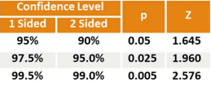


Sample Size – Improved Process
Improved process spending 5/10 to 5/30
Do we have enough data to determine process has improved?
Ha: mu improved < baseline
95% Confidence
Alpha = 0.05
1 sided, Z = 1.645
Baseline spending/week = $441.85
Improved spending/week = $340.67
E = baseline – improved = $101.18
s = 26.69
n = 0.188
n is small add 1.93 = 2.12
Round up = 3 weeks of data needed
Have 3 weeks of data
Conclusion: data is sufficient to say process has improved with 95% confidence level
Do we have enough data to determine goal has been met? (goal is $50 or more reduction)
Ha: mu improved =< baseline - $50
95% Confidence
Alpha = 0.05
1 sided, Z = 1.645
Baseline spending/week = $441.85
Improved spending/week = $340.67
Goal = (baseline - $50) = $391.85
E = goal - improved = $51.18
s = 26.69
n = 0.74
n is small add 1.93 = 2.67
Round up = 3 weeks of data needed
Have 3 weeks of data
Conclusion: data is sufficient to say goal has been met with 95% confidence level

Slide 12
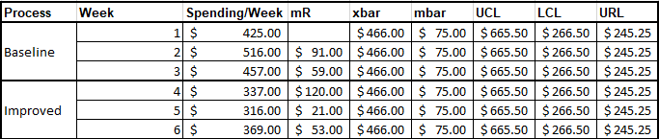
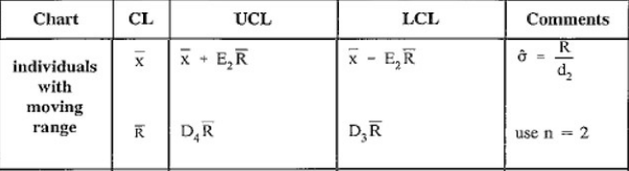

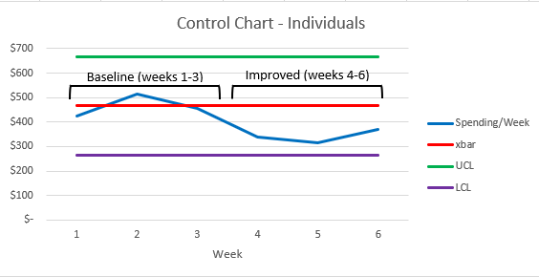
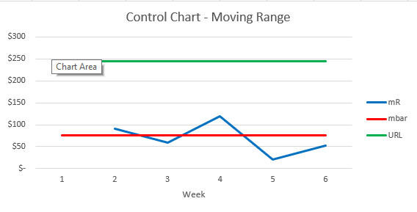
Control Charts IMR (continuous data, n=1)
Overview: The control charts are for total discretionary spending over six weeks taking one sample/week. The previous three weeks before improvement plan (4/19/21 to 5/9/21) were used for baseline. Three weeks with improvement plan (5/10/21 to 5/30/21) were used to check if process was in control.
Data
Calculations
xbar = average(first 3 weeks of spending) = $466.00
mbar = average(mR from weeks 2 & 3) = $75.00
Use n=2 for constants (D₃, D₄, E₂)
LCL = xbar - (2.66*mbar) = $266.50, UCL = xbar + (2.66*mbar) = $665.50
URL = 3.27*mbar = $245.25
Conclusions: Individuals chart shows reduction in spending, need more data points. The charts do not show the process being out of control.

Slide 13
Conclusions
Baseline Conclusions
The baseline process was broken and did not have any checks in place to control spending.
The largest discretionary expenses were for groceries and restaurants.
Restaurant spending was too high and sit down restaurants were the main reason.
Grocery trips were too frequent and grocery spending was more than what was needed.
Improved Process Conclusions
Adding checks and asking questions before making purchases at restaurants reduced the number of sit down restaurant purchases and also the overall spending at restaurants.
Putting a limit on the number of grocery store trips per week and requiring a grocery list be made improved the SQL for grocery trips.
Control charts show that the process is in control.
With a 95% confidence level the improved process has met the goal of reducing expenses by $50/week!
Going Forward
Need to continue to keep track of weekly data and check with controls.
Other purchase categories (other entertainment and movies/streaming) need to be reviewed for the possibility of reducing discretionary expenses further.

